Slide 1
Steady-state percept durations in bistable auditory stream segregation predict buildup dynamics
Steele, Tranchina, Rinzel

Slide 2
Auditory streaming
sound source identification
easier when different sound objects have different features, especially frequency content
there is not always one solution

Slide 3


Slide 4
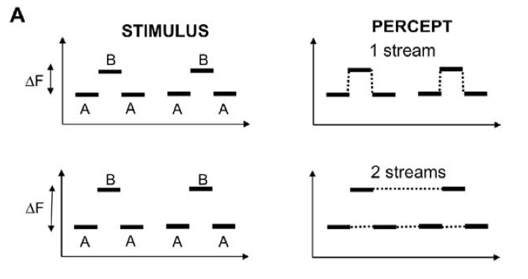
Bistability:
Horse-Morse
Can be perceived as having one or two sources
Similar to visual plaid moving gratings

Slide 5
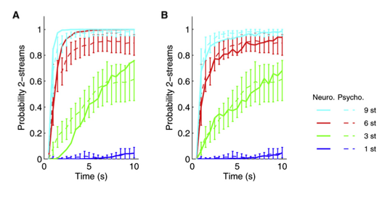
Buildup
Pressnitzer et al 2008

Slide 6
Dominance Durations
Follow a gamma or lognormal distribution
Could lead to buildup, if first epoch is lawfully set to “coherent percept”

Slide 7
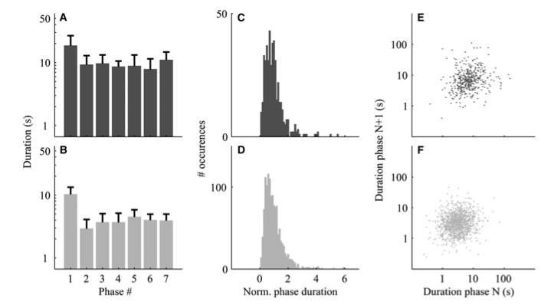
Pressnitzer & Hupe (2006)

Slide 8
Proof of concept- simulation

Slide 9
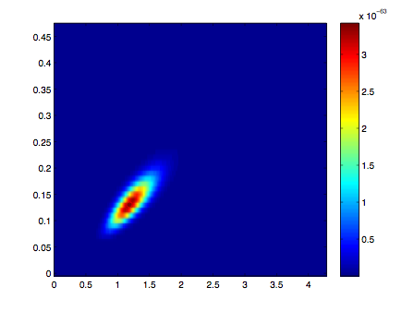
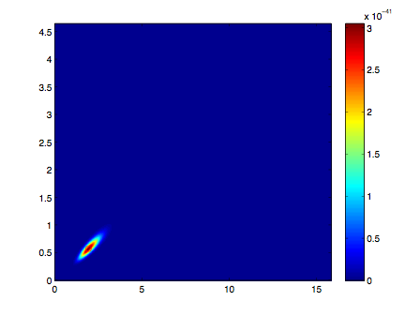
Confidence tests for MLE
plot likelihoods for every point in parameter space and see if it’s shallow or sharp

Slide 10
Construct empirical buildup functions
P(P(t)=segregated|P(t=0)=integrated)
“switch triggered average” excluding first percept duration

Slide 11
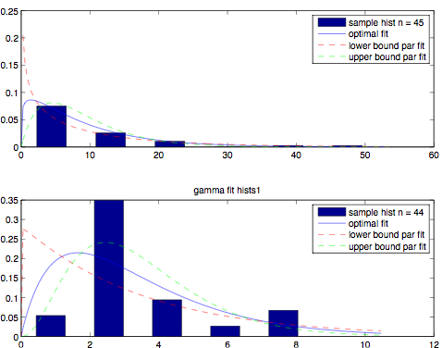
MLE fits to data
k = 1.1849 th = 7.6
k = 1.9380 th = 1.7

Slide 12
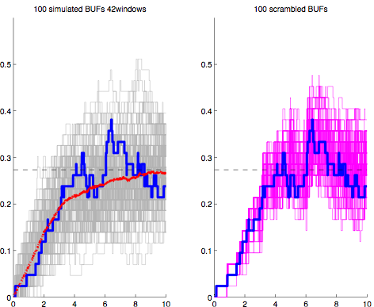
buildup fxn from data
simulated
scrambled

Slide 13
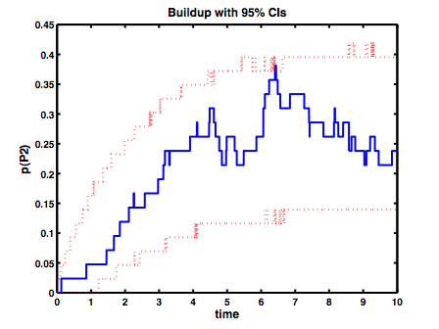

Slide 14
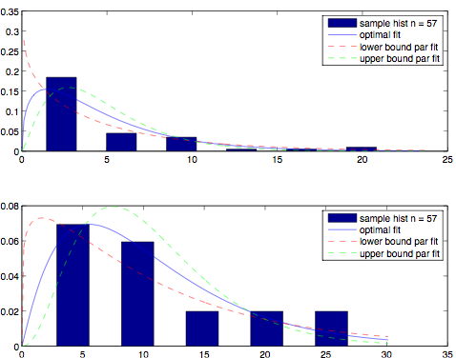
k = 1.4494
th = 3.2563
k = 2.0832 th = 5.123

Slide 15
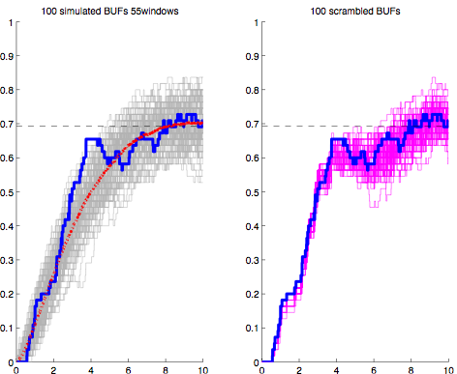

Slide 16
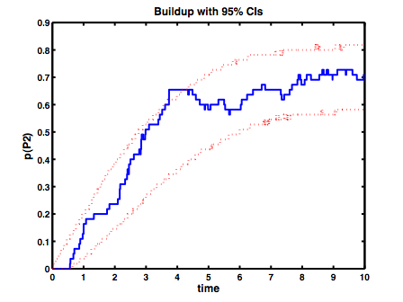

Slide 17
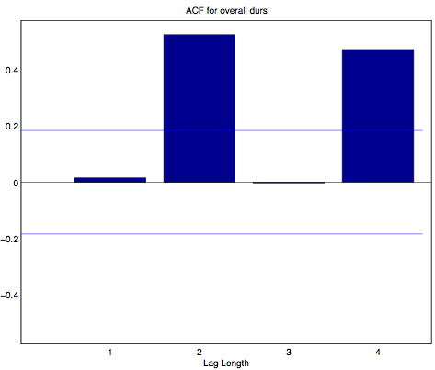

Slide 18
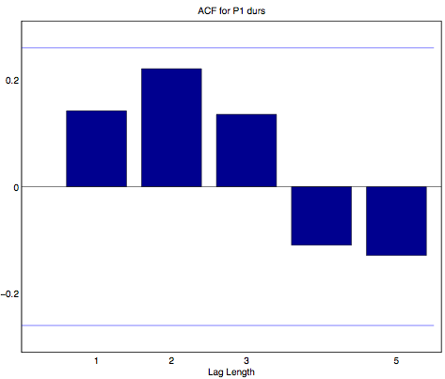
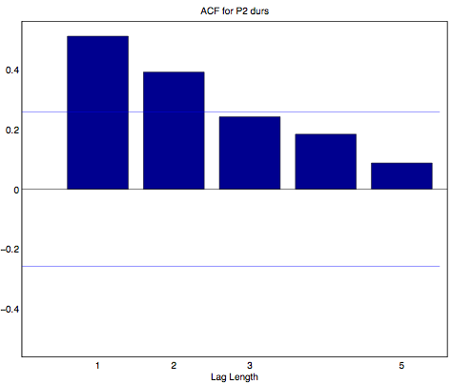
whats going on with these correlations

Slide 20
Why does buildup occur?
competition between neural populations
neuromorphic function- set a threshold for differential activation by the two tones, one at BF neuron and another at BF +/- dF
Adaptation based models should predict dependencies?

Slide 21
Future work
Mutual inhibition model simulations- test distributions of dominance durations and check for correlations
Incorporate first duration into our model

Slide 22
Auditory bistable percepts have been used to investigate stream segregation (van Noorden 1975). The characteristic dynamics of the perceptual time course leading to increased segregation over time is called buildup, and is typically observed over many trials. We conducted behavioral experiments with long (>4 min) presentations of ABA tone triplets with different frequency differences between the tones and found that the dynamics of buildup mid-trial could be predicted from the statistics of the steady state percept durations alone. By fitting a gamma distribution to the percept durations for each state (S1 or SII) we could simulate buildup functions that matched those found experimentally. In addition, the same buildup function is obtained whether the experimental time course is used intact or scrambled. This

